Slide 1
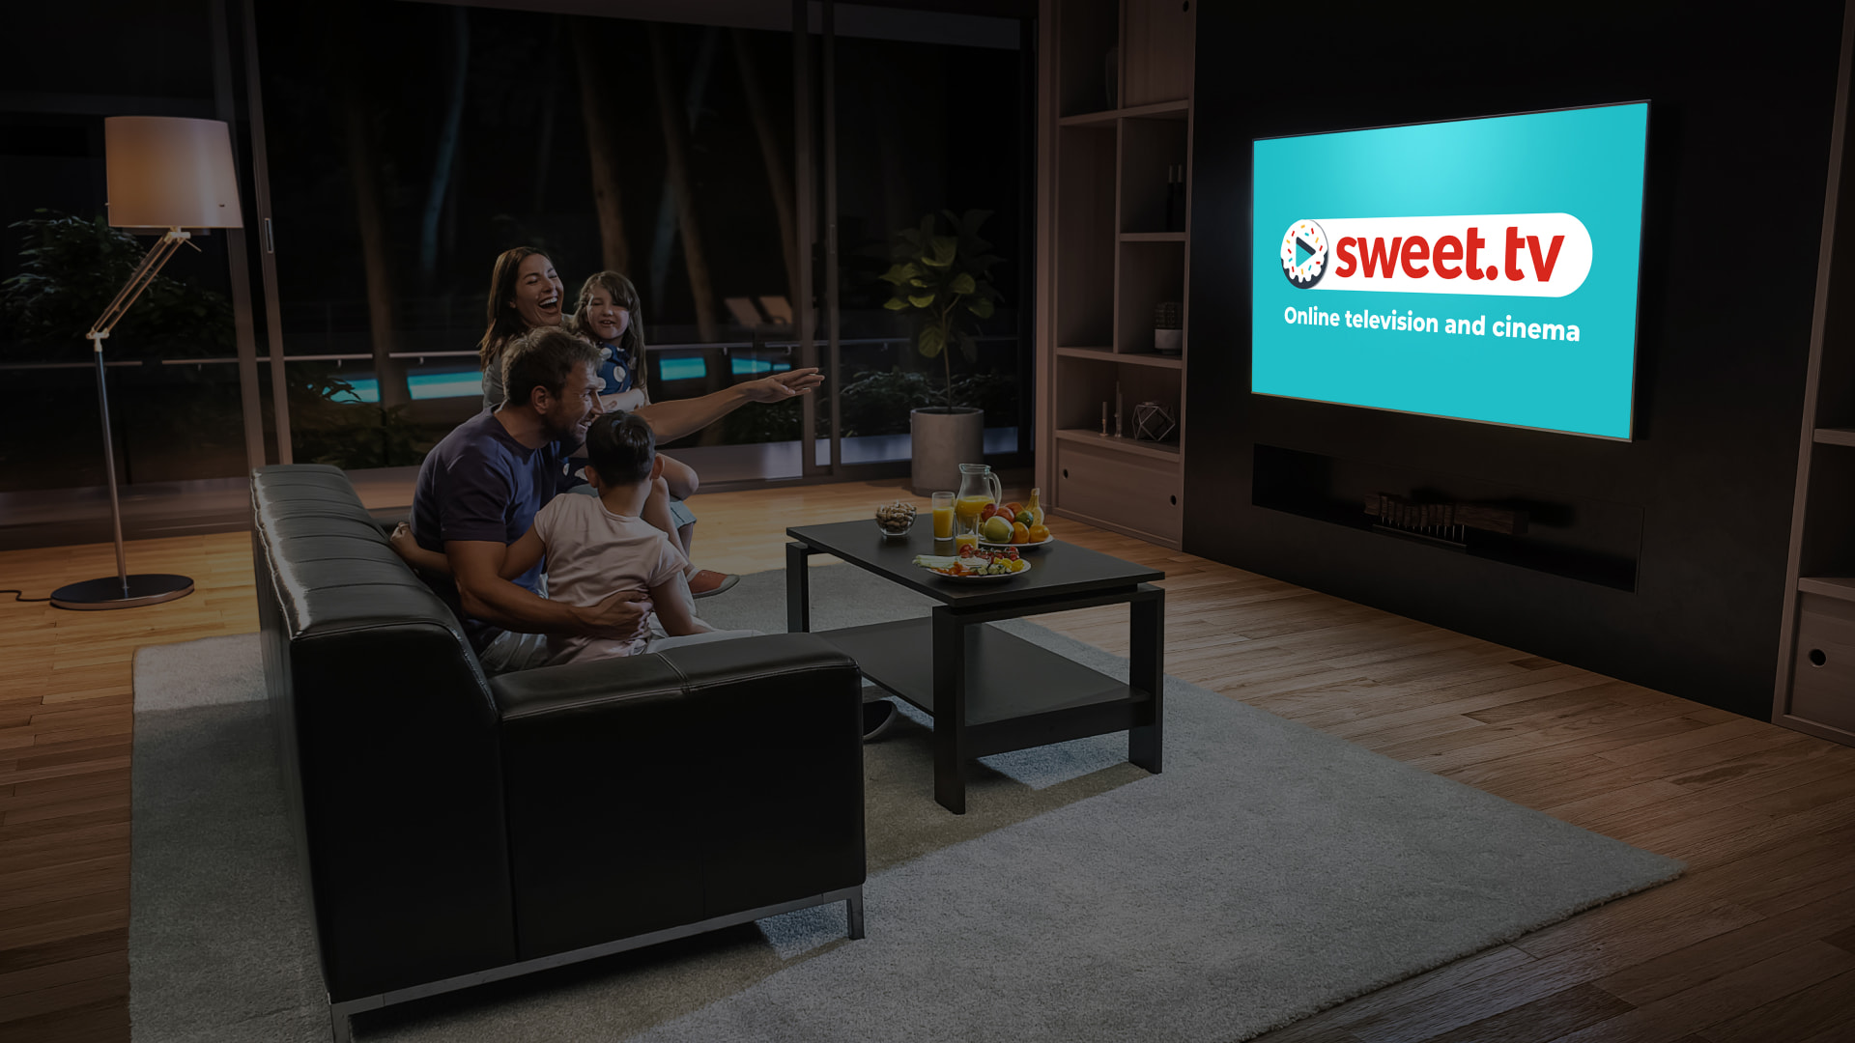


Personal offer
to launch OTT/VOD business

Slide 2
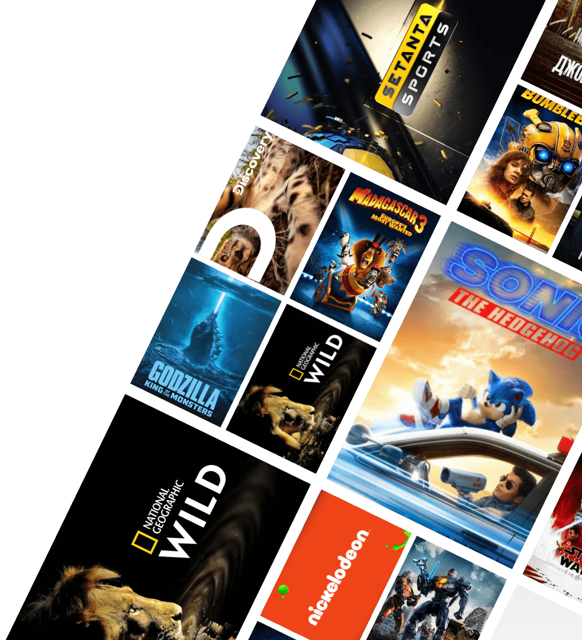


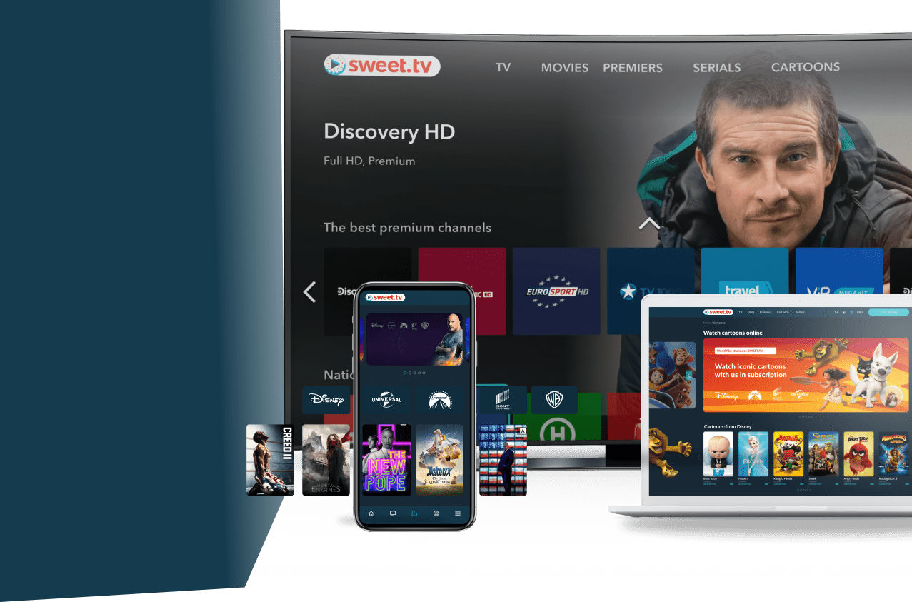
If you are looking for new business opportunities, the time has come to launch your own streaming platform. We are here to assist you in launching your own platform shortest time possible and with minimal effort!
Watch cult movies by subscription at no additional cost
“Obtain the OTT/VOD market leadership in today or tomorrow someone else will”
Main
TV
Cinema
Premieres
Cabinet

Slide 3
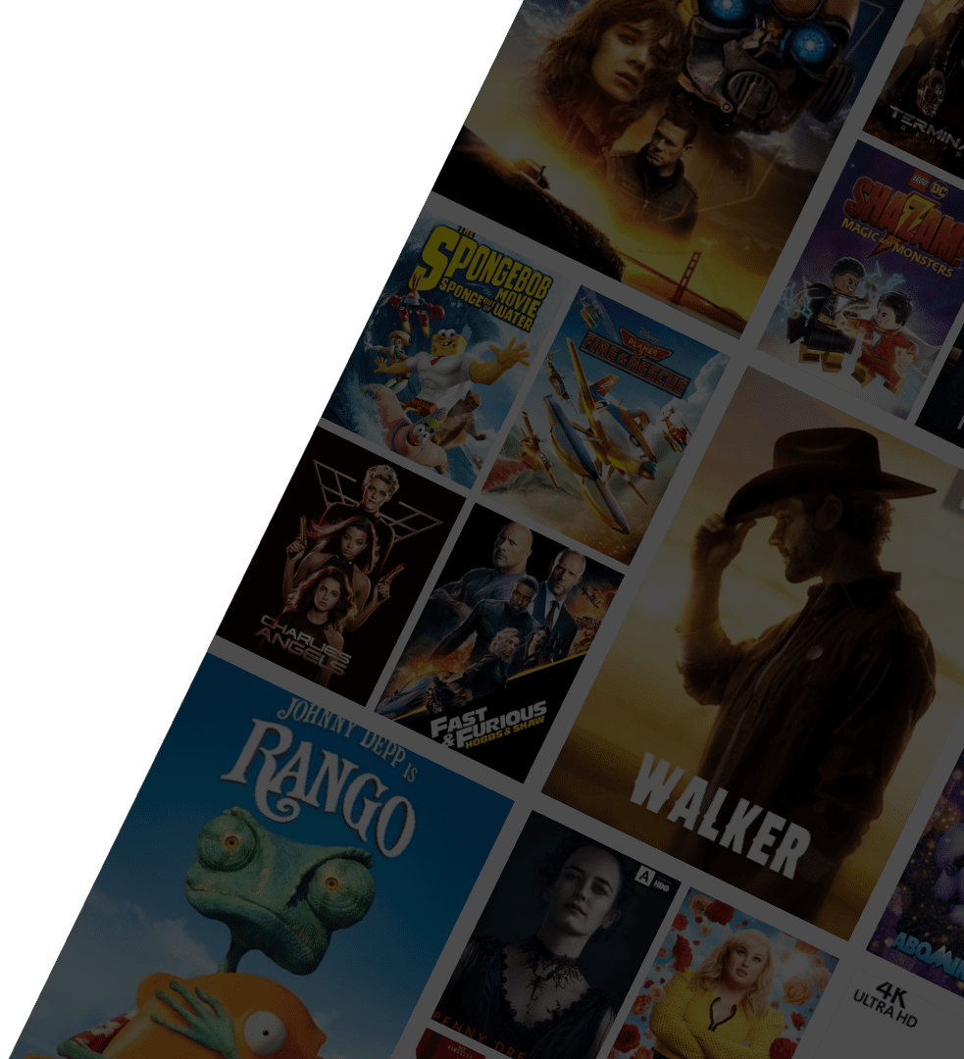

We offer you finished IT-solution - OTT/VOD-platform ready to launch!
Branding
24/7
complete service branding to the corporate identity
product technical support
DRM
Guarantee
full content copyright protection (DRM, etc.)
guarantee of smooth service operation under peak loads

Slide 4












More about us
SWEET.TV
8 years of experience in OTT / VOD platform design and development
Strategic partnership with Samsung, LG, Sony, Xiaomi, etc.
Successful launch of 20+ OTT products in White / Private Label format
Direct contracts with Disney, Universal, Paramount, etc.
300+ current B2B OTT partners

Slide 5





Benefits of our offer
The platform works smoothly despite the Internet speed. Watch the content in a remote village and while travelling
Xbox
Android
The service perfectly works on all devices. No need to buy a flagship to watch high quality content
Web (Windows, Mac, Linux)
Apple
User-friendly interface. Different modes for different level of user-awareness.
Available on all devices (platforms)
Smart TV
Set-top-box

Slide 6

2
Technical capabilities
Convenient payment system: billing crm and recurring payments system are integrated into the platform
Timeshift: put the TV program on hold, rewind or watch the record
All types of image quality: SD/HD/FHD/4K/8K
Watch offline: Download the content to APP library and enjoy it even without internet
Choose any language: Watch in any language with subtitles and without
Unlimited opportunities: create your channels, monetize any content

Slide 7



2
Monetization opportunities
Flexible system of promo codes
Referral programs
Content distribution according to AVOD / TVOD model
Ability to add advertisement for subscribers
Subscription model

Slide 8
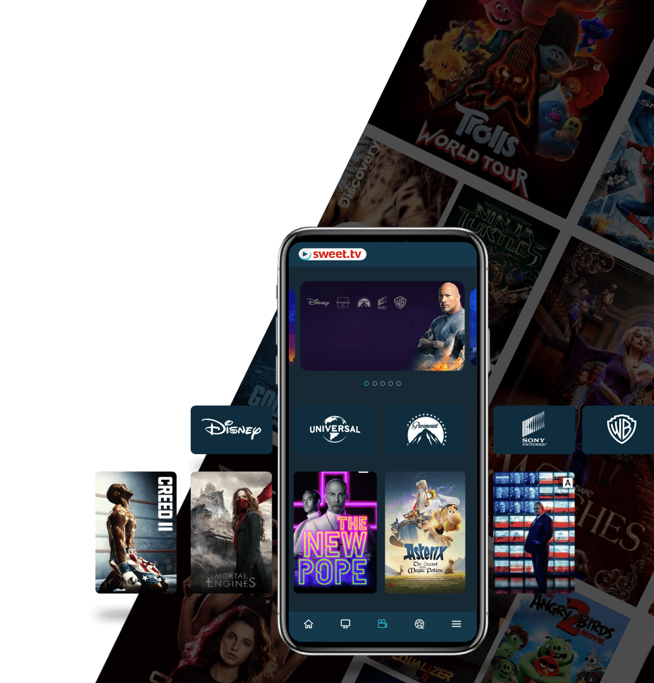
Сommunication Сhannels
The product provides a wide range of communication channels with users:
Targeted
Watch cult movies by subscription at no additional cost
Pop-up
Dispatch
banners in the app
E-mail/sms
push notifications in smartphones
Prerolls
Banner
before watching a video on demand
announcements in the app
Main
TV
Cinema
Premieres
Cabinet

Slide 9




2
To develop a similar streaming service from scratch, you need
54-60 months:
6-12 months to develop all types of technical requirements for platform and backend programming
36 months to develop applications for all platforms
6 months for design & UX/UI for each platform separately
6 months for testing and launching on each platform
$10 millions investment to:
Hire a team of 200+ developers
Purchase equipment: servers, streamers, etc.
Attract additional expertise
Correct errors and troubleshoot unexpected issues

Slide 10
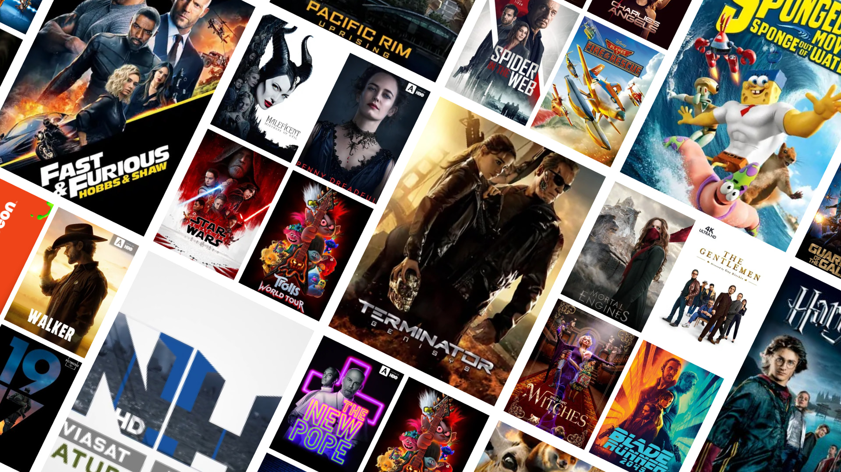

2
We offer a complete IT solution that will save your time and money
White/Private Label streaming platform
customized for your company
and ready to launch
in 3 months

Slide 11

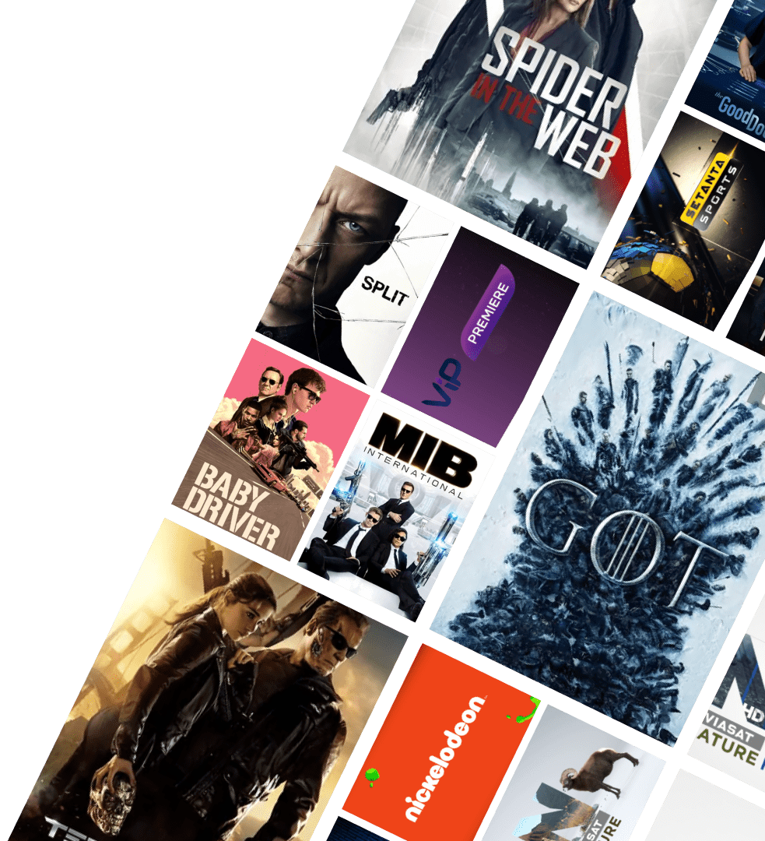
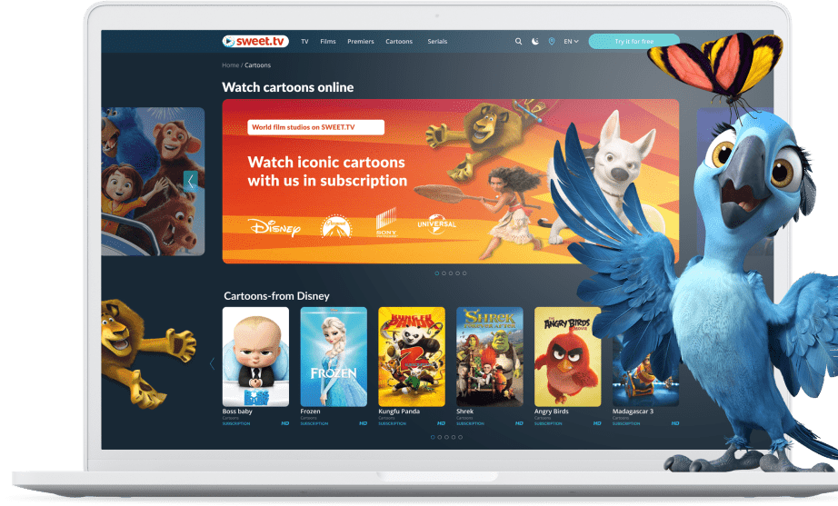




2
Let’s summarize
You receive a finished IT-product completely adapted to your tasks:
brand design in your corporate style
stable operation of the platform without any need to hire a dedicated in-house programming team
high performance under peak loads
24/7 technical support of the product by an experienced programming team

Slide 12
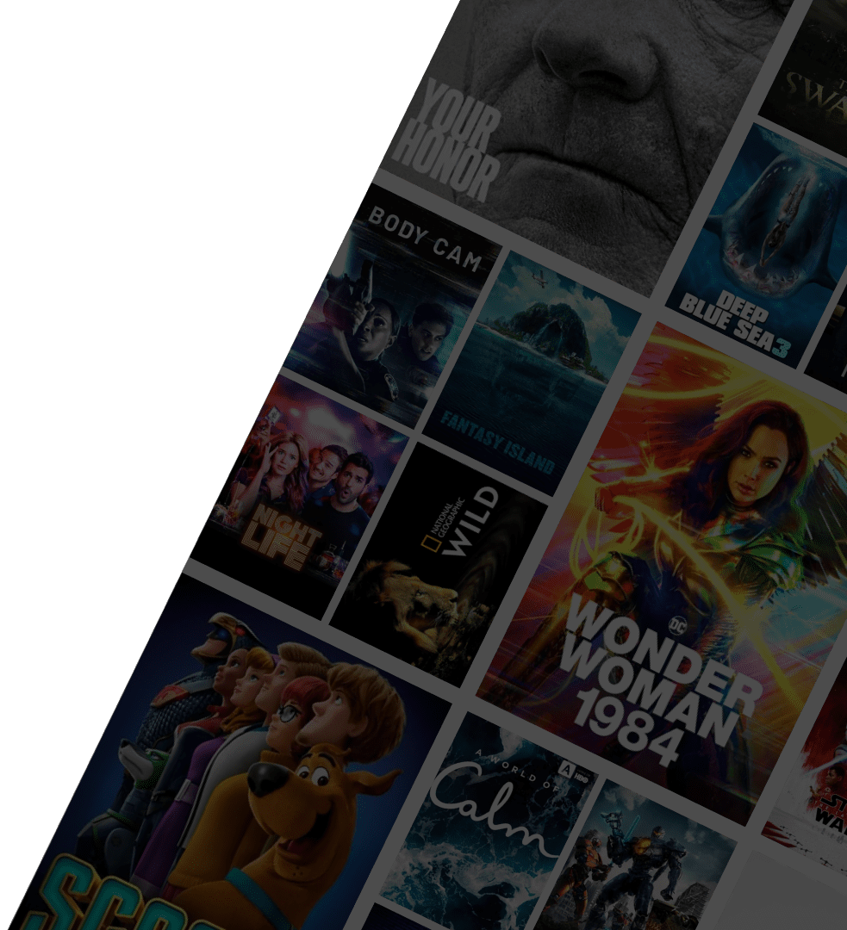
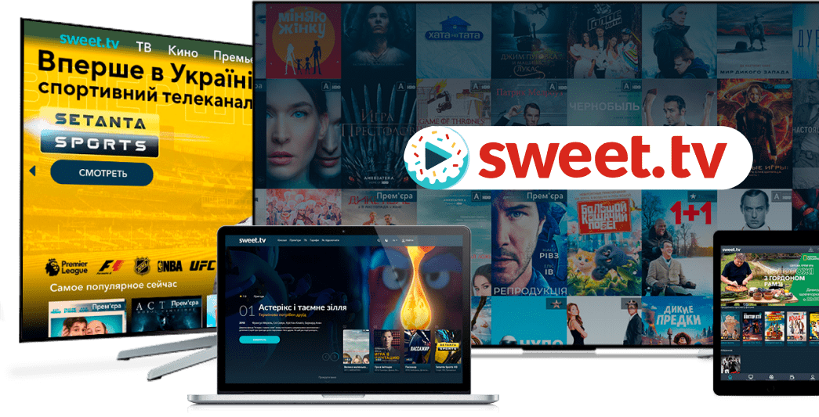




Why partner us?
SWEET.TV is an IT-company of 400+ professionals:
270
20
50
developers
designers
content managers
We provide a ready-made White / Private Label solution
Only 3 months required to adapt the OTT service
for your company
We will provide full support for its work after the launch

Slide 13

2
Effective client engagement model
Based on our own experience we know how to bring an OTT-product to the market and attract subscribers in shortest time possible
We are ready to offer support in building your sales funnel:
In App store/ Play Market systems
Promotion in Google, Facebook
Referral program development

Slide 14
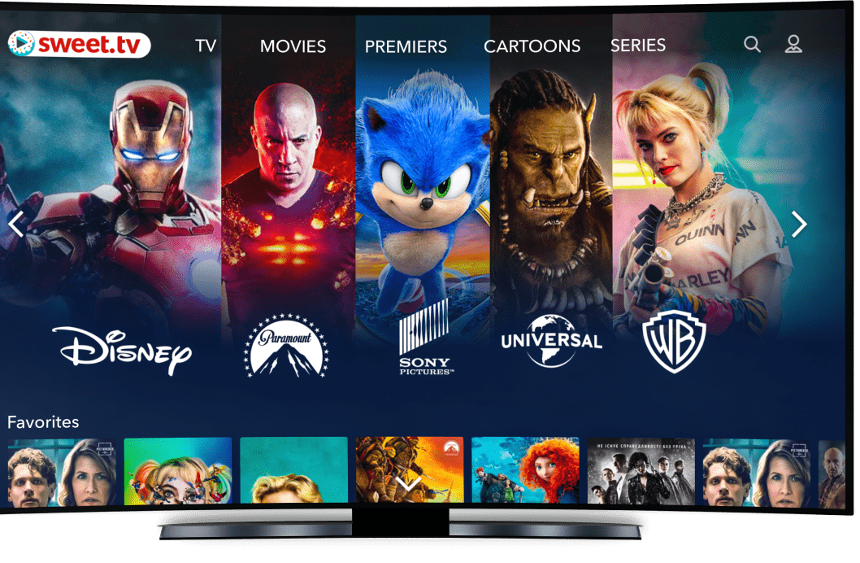






2
They already trust us

Slide 15
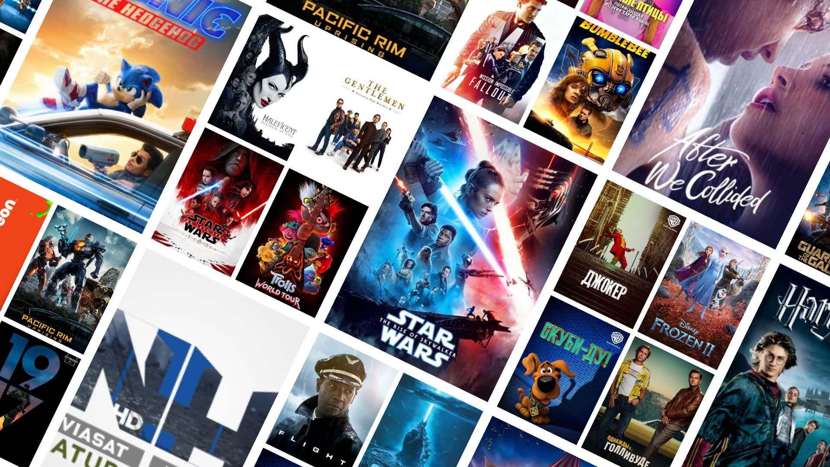



2
Katarina Dornerova
SWEET.TV contacts
dornerova.k @sweettv.eu +421948141969
VAN GROUP s. r. o Mostova 281101 Bratislava

